Slide 1
MRS Symposium Nov 28 - Dec 4

Slide 2
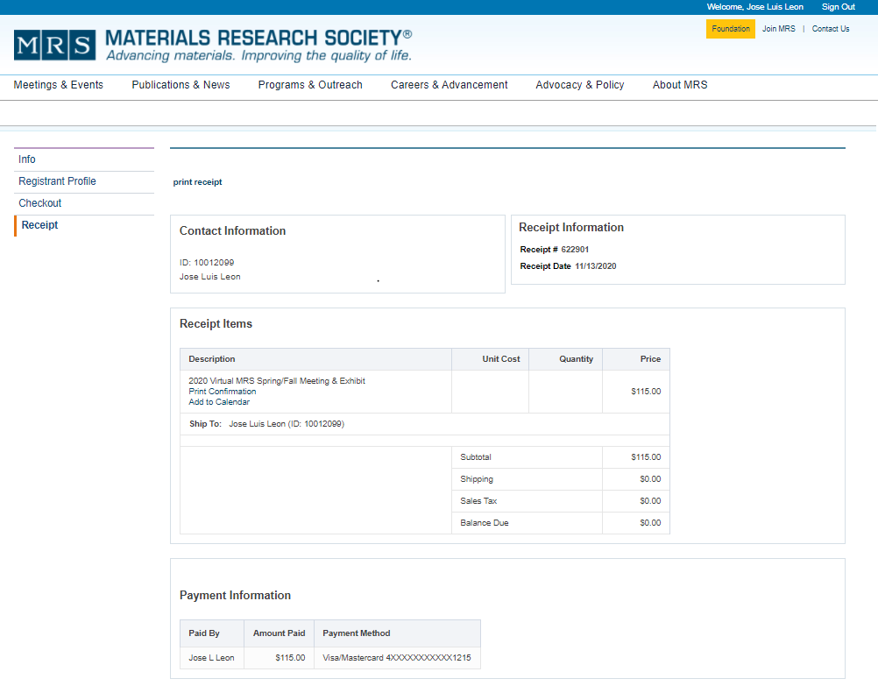
MRS-Symposium check-out

Slide 3
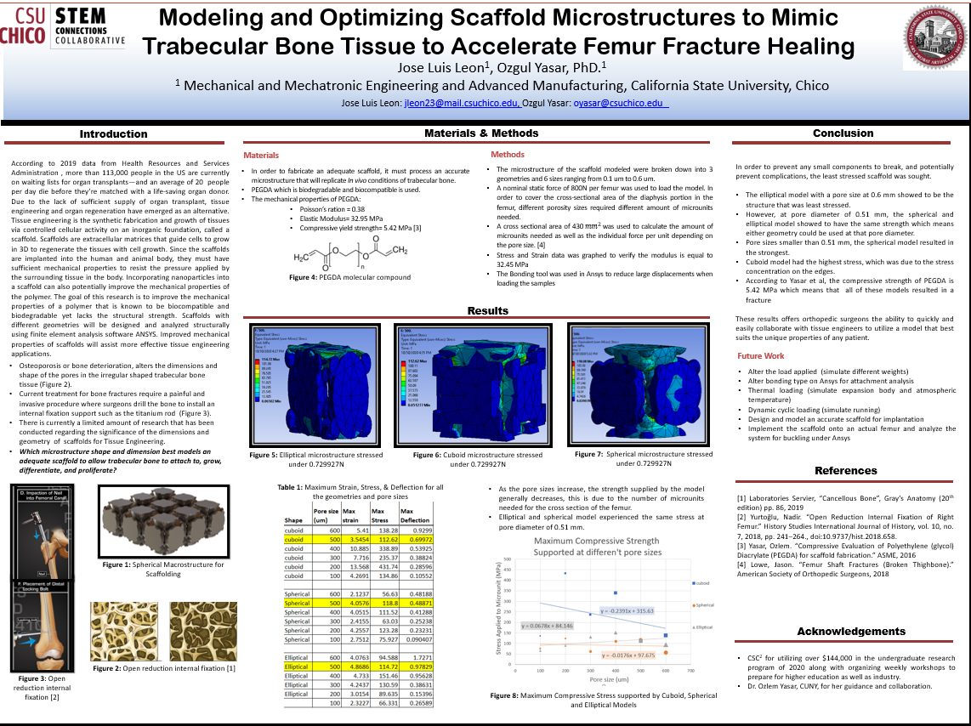

Slide 4
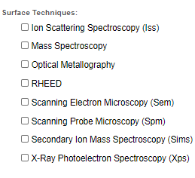
Questions

